Slide 1
Section 3.1 TOVS and Midpoints
© Copyright all rights reserved to Homework depot: www.BCMath.ca

Slide 2
I) Making a Table of Values
When given an equation, you can make a table of values (TOV) by picking some values for “x” and then solve for “y”
In a line equation, every value of “x” will generate ONE value for “y”
Each pair of “x” and “y” will make up a pair of coordinates for the line
Ex: Given the following equation, complete the following table of values:
Using the equation, make x=0, and solve for “y”
Now complete the table by doing the same thing when “x” is 2 and 3
For the last pair, make “y” equal to zero and solve for “x”

Slide 3
Practice: Use the equation given to complete the following TOV:
If no values are given for “x”, then pick a value for “x” yourself.
Hint” Try to pick values for “x” that are easy to calculate: ie: 0, 1, 2, 10,….

Slide 4
II) What is a Line Made of?
A line is actually made of many points (dots) that satisfy the equation.
If you zoom into a graph, you see a lot of tiny points that “line up” together
If keep zooming in, you get a lot more tiny points that line up together
Given the equation, complete the following table of values
3
y
0.4
2
0.2
1
x
1.2
1.3
1.4
1.5
1.6
1.7
1.8
1.9
2
-0.2
x
-1
0
1
2
3
-0.4
-1

Slide 5
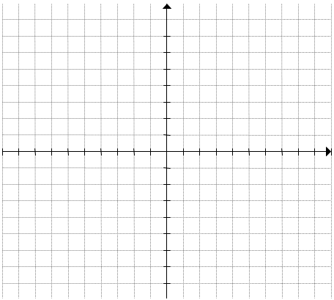
A line is actually made up of billions of points (dots)
Every single point on the line will satisfy the equation!
If you plug any coordinate on the line into the equation, both sides will be equal!!

Slide 6
Practice: Which of the following points will be on the line given by the equation:
Since only the third point satisfies the equation, then the third point (3,3) will be on the line

Slide 7
III) Linear Functions
A linear function is a straight line
The exponent of both the “x” and “y” variable must be whole numbers and is at most one
Neither “x” or “y” can be in the denominator
Ex: Indicate which of the following is a linear function
NO! B/C….
NO! B/C….
YES!
Exponent of “x” is 2
Exponent of “x” is 0.5
NO! B/C….
NO! B/C….
YES!
Exponent of “x” is in the denominator
Exponent of “x” is in the denominator if “y” is isolated

Slide 8
IV) Midpoints
When given the endpoints of a line, the midpoint can be found by taking the average of the coordinates
Ex: Given the points A(-3,1) and B(6,9), find the coordinates of the midpoint
Take the average of the two “x” coordinates to find the x-coordinate of the midpoint
The coordinates of the midpoint will then be:

Slide 9
Given the vertices of ∆PQR, P(-2,-6), Q(-8,10) and R(8,-1), find the midpoints of each side. What is the area of the triangle created by the midpoints?

Slide 10
Ex: The midpoints of a ∆ABC is as given: M₁(1,4), M₂(-3,8), and M₃(-5,-2). What are the coordinates of vertices “A”, “B”, and “C”?

Slide 11
Challenge: A line segment with endpoints A(-10,5) and B(8, -8) is cut into 5 equal parts. What are the coordinates of the four points used to divide AB?

